Slide 1

IIT Patna
Big Oof Notation
IT Challenge

Slide 2



Contents
Introduction to the Topic
Benefits & Motivation
Existing Methodology
Proposed Framework
Prototype Walkthrough
Tech Stack Used
Future Prospects
References
01

Slide 3
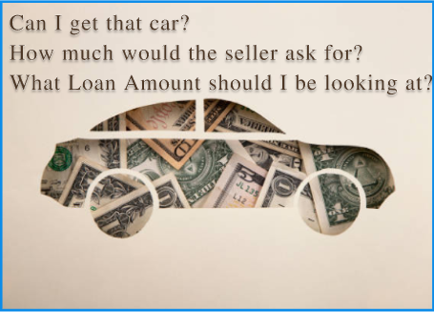
Introduction
Image Based Vehicle Information Fetching for Valuation & Damage Detection
Vehicle valuation refers to estimating the monetary worth of a motor vehicle. Customers and Companies alike use this during and before the loan application process for used vehicle to determine the market value of the vehicle, the subsequent eligibility and the amount of the loan . Additionally it can be used to gain powerful insights into insurance requirements, the legitimacy of the parties involved and enhance overall customer experience.
02

Slide 4
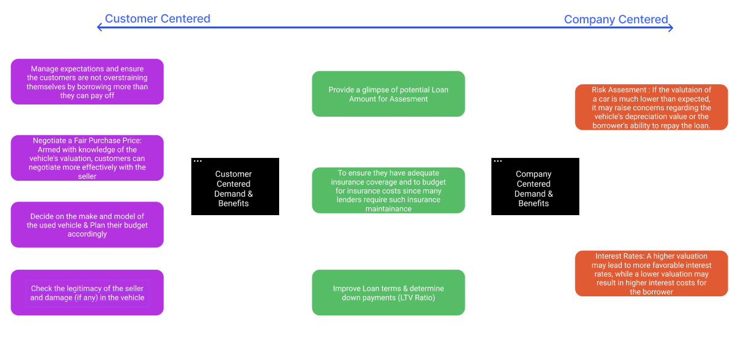
Benefits & Motivation
03

Slide 5
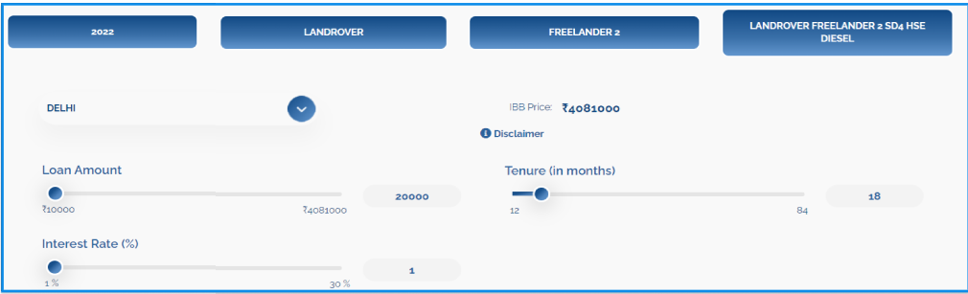
Existing Methodology & Tool
The following information are manually fed from the user : Year of Manufacture, Brand and Model of car, along with Variant and the City/State.
Existing tool channels this information to the Indian Blue Book(IBB) to suggest an IBB Price.
Subsequently, the Term payment can be estimated upon entering the Tenure, with an Interest Rate and the Loan Amount
04

Slide 6
Existing Methodology & Tool
Areas for Innovation Found with Existing Tool
The tool offers a static and generic price that may not capture the dynamic market conditions
Not Personalized to the vehicle in question. Cannot Fetch any other information about the vehicle in question (such as capacity, age etc.).
Does not say anything about the condition/ damage (if any) in the vehicle
Need to know about the specifics of the vehicle such as its variant and model before going forward. Thus, a prior degree of manual research is required
Dedicated Inspectors might be needed to gather the above information, which might cost money and energy
No such tool available for the mobile application, where mobile camera can be directly used to click and upload a picture
05

Slide 7
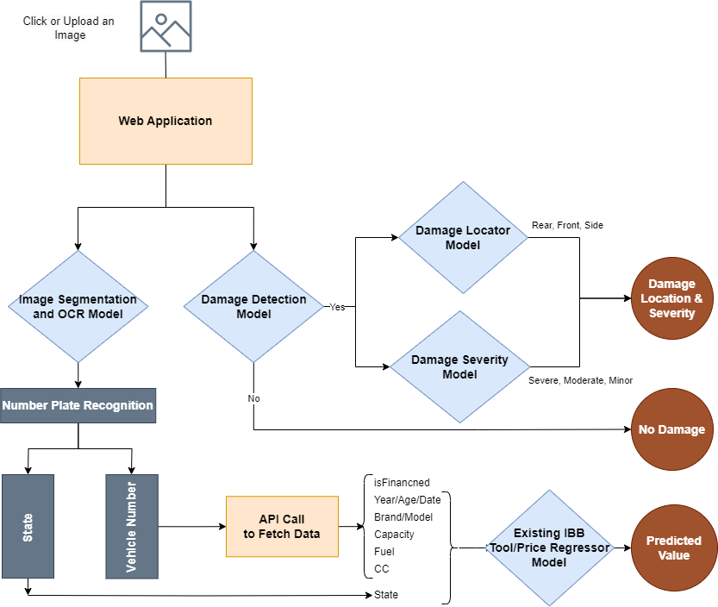
Proposed Framework
06

Slide 8
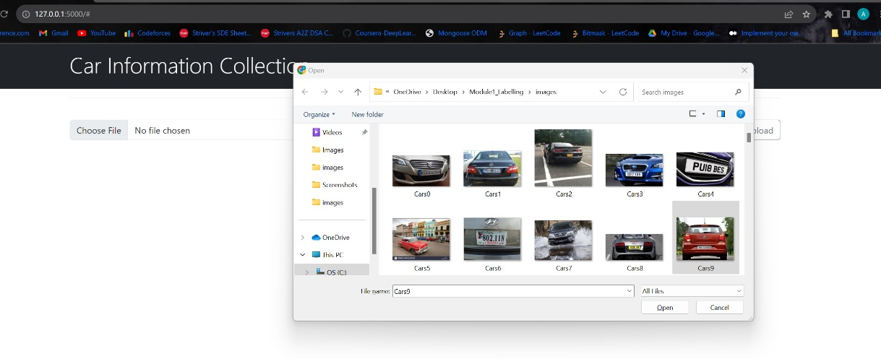
Prototype Walkthrough
Part 1 : Uploading the Image to the Web App
07

Slide 9
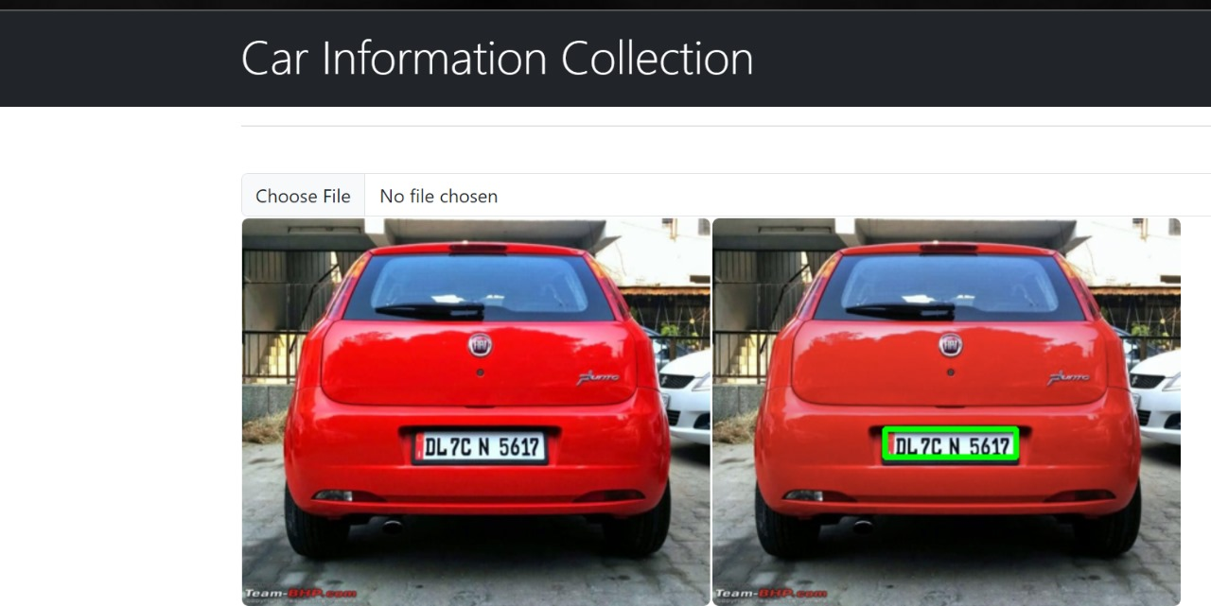
Prototype Walkthrough
Part 2 : Recognising the Vehicle Number using Segmentation and OCR
07

Slide 10
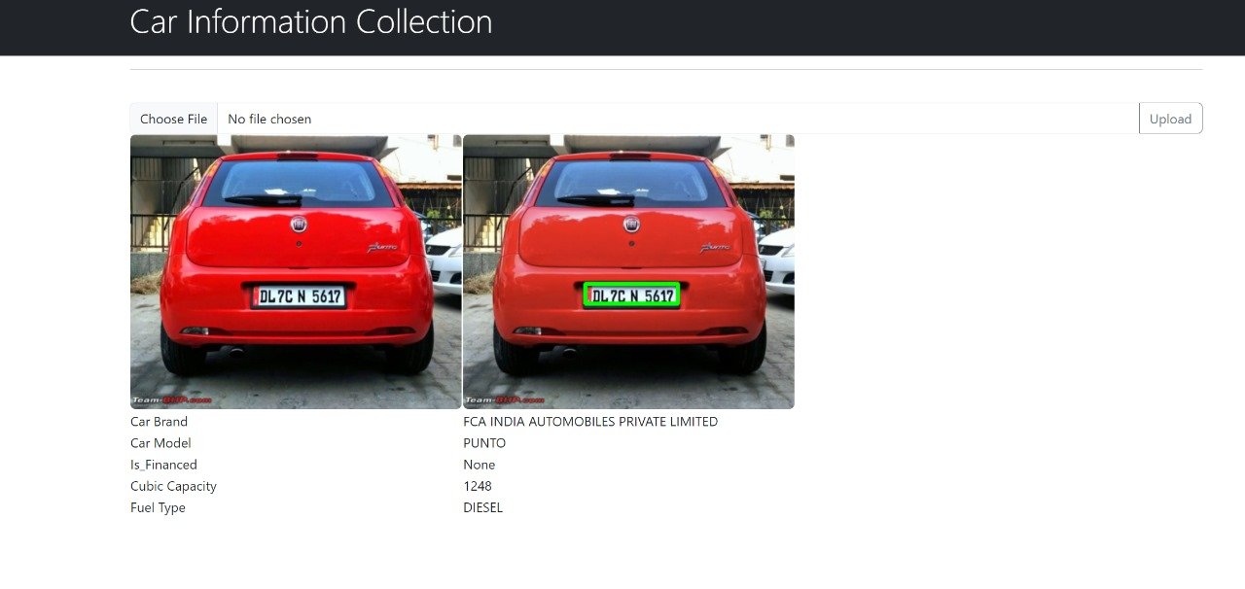
Prototype Walkthrough
Part 3 : API Call and Fetching Vehicle Information
07

Slide 11
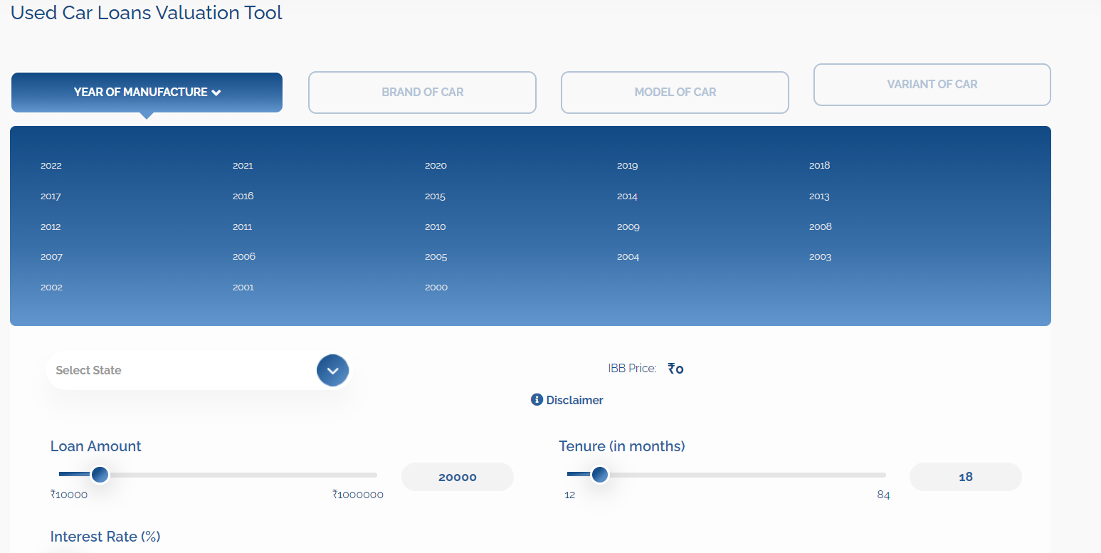
Prototype Walkthrough
Part 4 : Channelling the Information Fetched to a ML Regressor Model/ Existing IBB Tool
The Information Fetched can be put into the
existing tool or to an existing ML Regressor Model
(such as xGBoost ) to predict the price
07

Slide 12
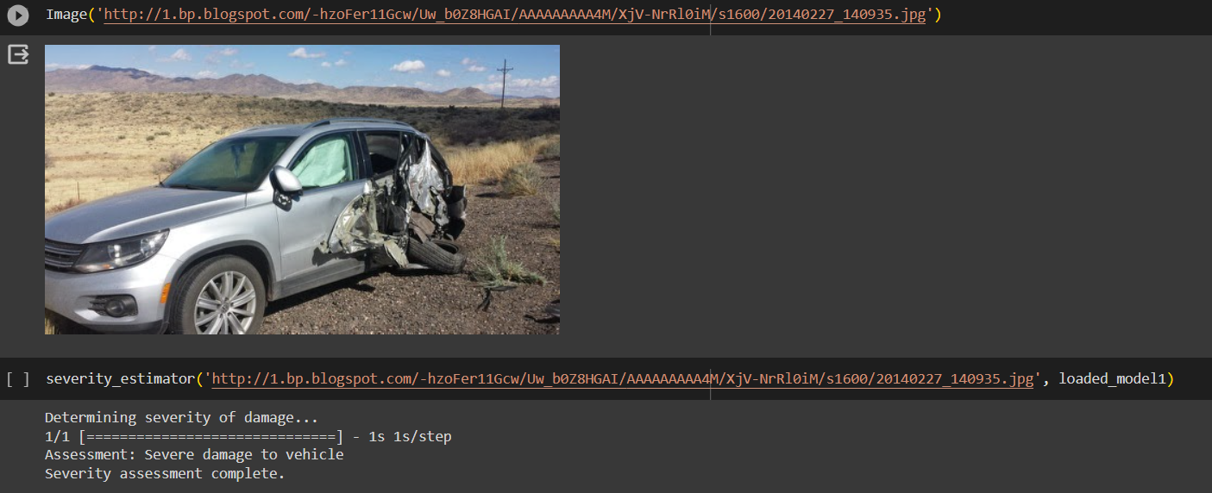
Prototype Walkthrough
Part 5 : Checking the Car for damage and Assessing Severity and Location
07

Slide 13








Tech Stack Used
08

Slide 14
Future Prospects
Migrating the system to the mobile application so that Phone Camera can be used “on the fly” for direct scanning/clicking photos of the vehicles
Integration with the existing IBB System so that the model/variant and subsequent information can be directly fetched from a image and then channeled to the existing to system.
Developing a hierarchical system for the two models such that the output from one is a input feature for another and further comparison of the performance of such an system. Accurate prediction for repair costs may lead to a better and more on-point valuation of the vehicle.
09

